Slide 1



B2C E-COMMERCE
MURUGAPPA POLYTECHNIC COLLEGE
Sathyamurthy Nagar, Chennai-600 062.
(An Academically Autonomous Institution)
DEPARTMENT OF COMPUTER ENGINEERING
PROJECT REPORT ON
MOHAN KUMAR B - 1811804
SANJAY M - 1811813
BALAJI D - 1912247
DURGESH K - 1912251
MANOHARAN S - 1912267

Slide 2
SYNOPSIS
Since almost all the buyers nowadays prefer online shopping due to its many benefits, the greatest opportunity for e-commerce companies is to build a longlasting and profitable relationship with this already existing audience. For making strong relationship with these users it is very important to focus on the customer as a whole and making sense of a flood of real-time information that goes well beyond demographics or shopping behavior. There are two entities who will have the access to the system. One is the admin and another one will be the registered user. Here the Admin will not only add the product with its details such as product name, description, features, warranty, add on product and delivery date but also the admin can view and edit the product information whenever required. Admin can view all the order details and can also view the sales of the products.

Slide 3
SYNOPSIS
User need to register with basic registration details to generate a valid username and password. After the user logins, it can view all the products that are recommended on the homepage compiled by the system based on users information. From the recommended products, the user can even further view its details and then if interested to buy, the system gives add to cart option for purchasing the product. The system even has an AI bot with the help of which the user can get answers to queries like features, warranty, price etc. details of the products. After selecting the product, user can do payment for the particular product online. Users can view their order history of their purchased product.

Slide 4
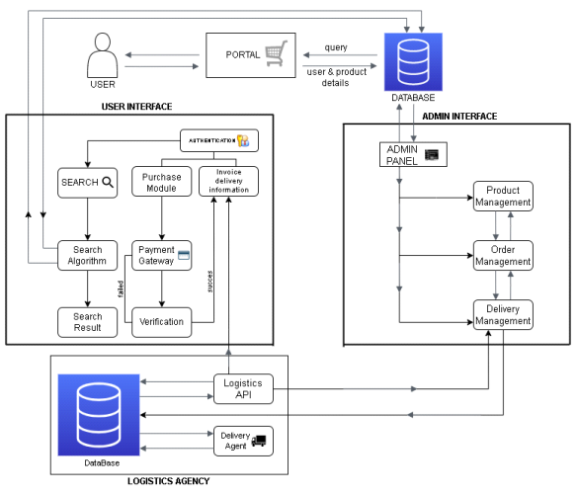
SYNOPSIS

Slide 5
MODULES DESCRIPTION
USER
ADMIN
CONTENT MANAGEMENT
ORDER MANAGEMENT
PAYMENT
SHIPPING

Slide 6
1. USER
The Application enables the user to register themselves with the ecommerce portal. Way the application can store purchase history, can track purchase and can send time bound newsletter specifying new deals, offers, promotional materials etc... Other than the customer database can be used for making survey do decide product inventory product promotions etc...

Slide 7
2. ADMIN
This module is used to store the database from which the product details to
be stored & retrieved
• This process enables the admin to ADD, DELETE items or product details,
description, color, weighing with option do upload image of the product and
pricing
• This module has to view the information details also provided.
• Which user entering to the shopping market, then provided to the which
product how much cost,weight,mfg etc.., also providing
• these details are stored in the database server if a system call from the user
for a unique product id that particular product details are given back to the
user.

Slide 8
3. CONTENT MANAGEMENT
• Product Listening. Ecommerce application demand the listening of the products features.
• Product Review. A review is an evaluation of a product with making which helps after buyer to decide on the purchace. Our online application is empowered with product review to help consolidate user opinion about a particular product.

Slide 9
4. ORDER MANAGEMENT
Ecommerce system required the products to be mentained available or not. If available,intended buyer have the freedom of product ordering through adding the product in the shipping cart. To be more specific, buyer can locate the product or goods by searching the key parameters or locate through product categories and the can add the product to the cart for futher processing

Slide 10
5. PAYMENT
Payment gateway integration into ecommerce website is a good way of accesing payment for products or services offered by the online shopping. This is responsible for tracking the payment states and places the order.

Slide 11
6. SHIPPING
The module helps the client to enter the product shipping details with address and the system calculate if there is any shipping charges to be lived based upon the shipping location.

